Slide 1
Warm Up
Supplies Needed:
Volume 2 textbook
Graphing Sheet, Ruler, 1 Sheet of Patty Paper (Back table)
Read the article on page 4 of the scholastic
magazine.
DO NOT WRITE ON THE MAGAZINE

Slide 2
Check HomeWork

Slide 5
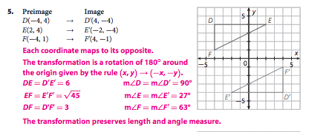

Slide 6
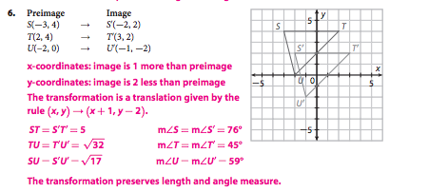

Slide 8
Objective
Identify and draw translations.

Slide 9
What is a translation?

Slide 10
Ohio State Marching Band
https://www.youtube.com/watch?v=v3vp7H3eEfs
Work on Translation WS with group!

Slide 11
What is a translation?

Slide 12
Translation
A transformation that shifts or slides every point of a figure or graph the same direction in the same distance.

Slide 13
What kind of Translation is this?
(x, y) → (x + 5 , y)
(x, y) → (x – 3 , y)
(x, y) → (x , y + 2)
(x, y) → (x , y – 4 )
(x, y) → (x – 6, y + 8)
5 units right
3 units left
2 units up
4 units down
6 units left, 8 units up

Slide 14
Patty Paper Time!
Draw a triangle that is smaller than a fourth of the size of the patty paper on your blank piece of paper. Label the vertices of the triangle.
Copy the triangle onto the patty paper.
Using your patty paper, translate your triangle to somewhere else on your paper. Label your new points with prime marks.

Slide 15
Patty Paper Time!
Using your ruler, connect the preimage vertices to the image vertices.
Measure each of these segments.
What do you notice?
Are these segments parallel, perpendicular, or neither?

Slide 16
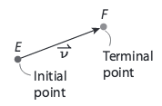
These segments are… Vectors!
pg. 834
A quantity that has both direction and magnitude.
The initial point of a vector is the starting point.
The terminal point is the ending point.

Slide 17
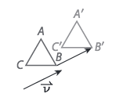

Slide 18
Vector Video
https://www.youtube.com/watch?v=A05n32Bl0aY

Slide 19
pg. 836
A vector in the coordinate plane can be written as <a, b>, where a is the horizontal change and b is the vertical change from the initial point to the terminal point.

Slide 20
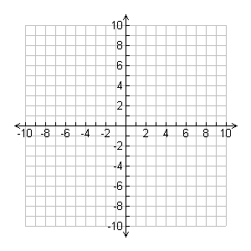
Try It Out!
Draw a Triangle with coordinates T (5, 5) R (5, 7) and Y (8, 5)
Use the Vector $<−6, −6>$to translate the triangle

Slide 21
Try It Out!
Draw a Triangle with coordinates B (1, 1) O (3, 2) and L (5, 1)
Use the Vector $<−3, −4>$to translate the triangle

Slide 22
Try It Out!
Draw a Triangle with coordinates B (1, 1) O (3, 2) and L (5, 1)

Slide 23
Try It Out!
Make your own triangle and vector!

Slide 24
What would the vector be?
(x, y) → (x + 5 , y)
(x, y) → (x – 3 , y)
(x, y) → (x , y + 2)
(x, y) → (x , y – 4 )
(x, y) → (x – 6, y + 8)
$$<5, 0>$$
$$<−3, 0>$$
$$<0, 2>$$
$$<0,−4>$$
$$<−6, 8>$$

Slide 25
Your Time to Design!
Come up with a “shape” that could be used for the marching band and also come up with a translation for how you want the shape to move!
The shape must have at least 5 vertices and must move to three different locations
You need to come up with the vertices for your preimage shape and the three translations for how you want the shape to move. The translations must be written in coordinate notation.
The shape needs to stay on the graph.

Slide 26
Exit Ticket
What did you learn today?
What mistakes were you making?

Slide 27
Homework
pg. 839 (1-10)

Slide 28
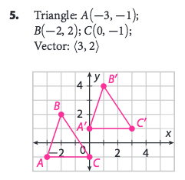
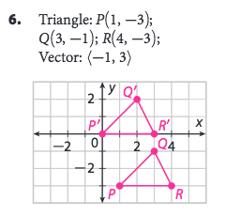

Slide 29
