Slide 1
Check Homework

Slide 2
Graphing Equations in Slope-Intercept Form
Objective:
Be able to recognize and graph a linear equation in slope-intercept form

Slide 3
Find and interpret the slope.

Slide 4
Guess the Rule
x | y
-2 | -5
-1 | -2
0 | 1
1 | 4
2 | 7
What is the value of y when x is zero?
What is the slope?
y = 3x + 1

Slide 5
Guess the Rule
What is the value of y when x is zero?
What is the slope?
x | y
-2 | 9
-1 | 7
0 | 5
1 | 3
2 | 1
y = -2x + 5

Slide 6
Guess the Rule
What is the value of y when x is zero?
What is the slope?
x | y
-4 | 9
-2 | 7
0 | 5
2 | 3
4 | 1
y = -x + 5

Slide 7
Guess the Rule
What is the value of y when x is zero?
What is the slope?
x | y
-4 | 10
-2 | 20
0 | 30
2 | 40
4 | 50
y = 5x + 30

Slide 8
Guess the Rule
What is the value of y when x is zero?
What is the slope?
x | y
-10 | -20
-5 | -40
0 | -60
5 | -80
10 | -100
y = -4x - 60

Slide 9
Slope-Intercept Form
y = mx + b
“m” is the slope
how much the graph increases or decreases for each “x”
“b” is the y-intercept
The value of y when x is zero (the “initial value”)
Always on the y-axis
(I’m not sure why they picked those letters. If you find out why you can share it with the class)

Slide 10
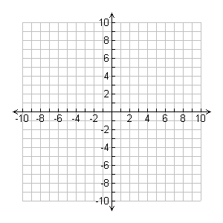
Write the equation:
$$y=−2x+4$$

Slide 11

Write the equation:
$$y=\frac{1}{2}x−5$$

Slide 12
Write the equation:
$$y=x+2$$

Slide 13
Write the equation:
$$y=2x−4$$

Slide 14
Draw the graph
$$y=−x+6$$

Slide 15

Draw the graph
$$y=−\frac{1}{3}x−3$$

Slide 16
Draw the Graph
$$y=3x+1$$

Slide 17

Graph:
$$y = \frac{3}{2}x − 6$$

Slide 18
Graph:
y = -3x - 2

Slide 19
Graph:
$$y =−\frac{1}{5}x+6$$

Slide 20

Graph: $y=\frac{1}{3}x+4$

Slide 21
What would the graph of y = 4 look like? Convince me.

Slide 22
What would the graph of x = 4 look like? Convince me.

Slide 23
Homework
Worksheet

