Slide 1
Bellringer
Work on the Warm Up Sheet
NEED:
Graphing Sheet
Protractor

Slide 2
Rigid Motions
Translations
Reflections
Rotations
Quiz Friday

Slide 4
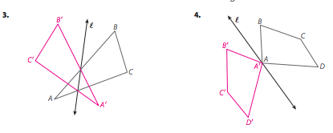

Slide 5
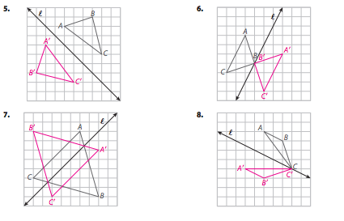

Slide 6
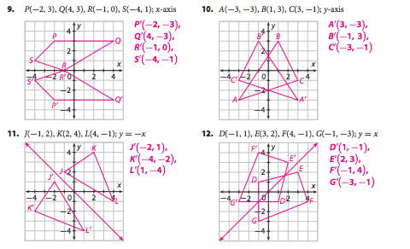

Slide 7
Let’s move onto our last rigid motion!

Slide 8
Objectives:
Draw rotations on a coordinate plane
Find the angle of rotation

Slide 9
Rotations Video (2 min)
https://www.youtube.com/watch?v=1sxmI4Y1K3s

Slide 10
Rotation
Transformation around a point, called the center of rotation.
Center of Rotation

Slide 11
Rotations
Every point and its image are the same distance from the center of rotation.

Slide 12
Rotations
All angles with the vertex as the center of rotation formed by a point and its image have the same measure. This angle measure is the angle of rotation

Slide 13
A useful strategy to help you rotate…
Physically turn the paper so that you can see where the shape should end up.

Slide 14
NOTE: ROTATIONS ARE ALWAYS COUNTERCLOCKWISE AND AROUND THE ORIGIN UNLESS SPECIFIED OTHERWISE!

Slide 15
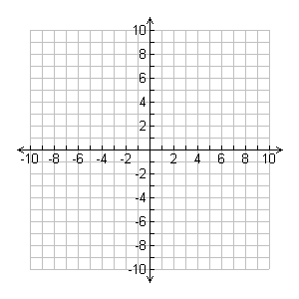
Challenge: ROTATE the shape 90º clockwise around the origin.
Coordinates:
A (-5, 4)
B (-5, 1)
C (-4, 1)
A
B
C

Slide 16
Challenge: ROTATE the shape 90º clockwise around the origin.
Coordinates:
A (-5, 4)
B (-5, 1)
C (-4, 1)
B’
A’
A
C’
B
C

Slide 17
Rotation Activity
Perform the three rotations on the figure.
After you perform the rotations, try to come up with a rule that represents the rotation!

Slide 18
Discussion
What rule did you come up with for
90° rotation counterclockwise
180° rotation
90° rotation clockwise
360° rotation

Slide 19
Rotation around the origin
90° rotation counterclockwise
(x, y)→(-y, x)
180° rotation
(x, y)→ (-x, -y)
90° rotation clockwise
(x, y)→(y, -x)
360° rotation
(x, y)→ (x, y)

Slide 20
Rotation
These rules only apply to rotation AROUND THE ORIGIN!!

Slide 21
Rotation about origin
What is another way to describe a 90° counterclockwise rotation? 90° clockwise rotation?
Why do 180° and 360° rotations have no direction?

Slide 22
Draw trapezoid ABCD. Then rotate it 90º counterclockwise.
Coordinates:
A (1, 6)
B (5, 6)
C (3, 4)
D (1, 4)
A
B
B’
C’
D
C
A’
D’

Slide 23
Rotate trapezoid ABCD 180º.
Coordinates:
A (1, 6)
B (5, 6)
C (3, 4)
D (1, 4)
A
B
D
C
B’
C’
A’
D’

Slide 24
Draw triangle ABC and rotate it 270º.
Coordinates:
A (2, 7)
B (6, 6)
C (6, 3)
A
B
C
A’
C’
B’

Slide 25
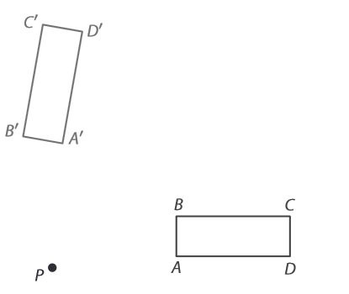
Finding the angle of rotation
Estimate: by what angle do you think these shapes are rotated?
80º

Slide 26
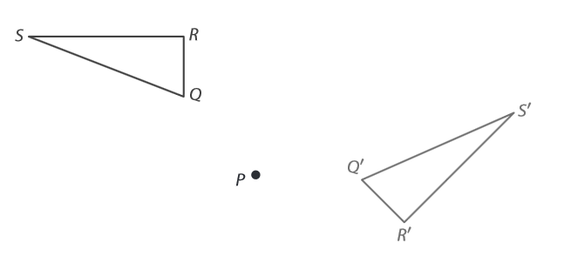
Finding the angle of rotation
Estimate: By what angle do you think these shapes are rotated?
135º

Slide 27
Review
Quiz will cover rotations, reflections, and translations
Work on Review Sheet
Study with review sheet and homework from this past week.

Slide 28
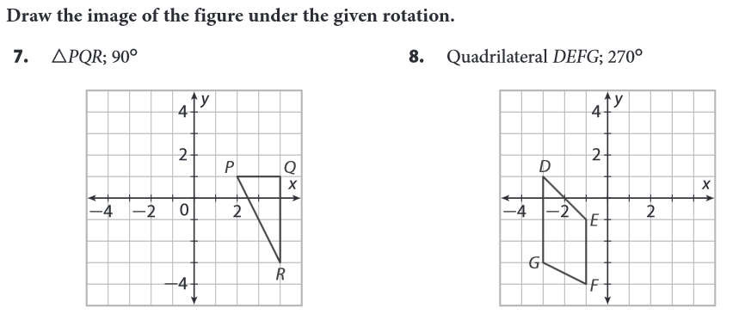
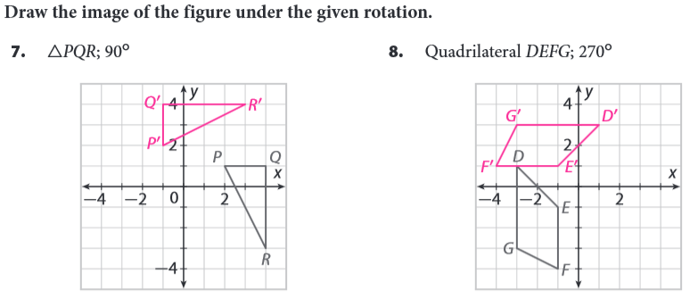
p. 862, 7 & 8

Slide 29
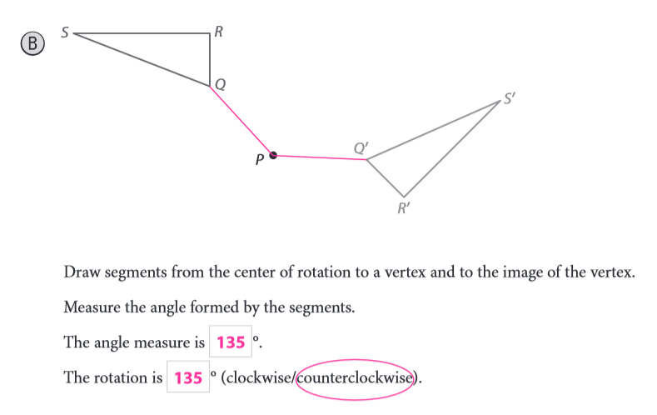
Measuring it EXACTLY…
Read p.862 Example “A” and then try Example “B”.

Slide 30
Homework
p.865 (5-10)

