Slide 1
Bellringer
Work on the Tuesday column of the white sheet
Do NOT work on any other column
Have your homework (pg 839) on your desk
NEED THESE SUPPLIES:
Ruler
One sheet of Patty Paper from the Supply Table

Slide 2
Today’s Objective:
Identify and draw reflections

Slide 3
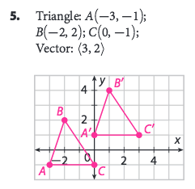
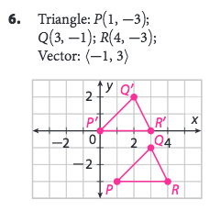

Slide 4
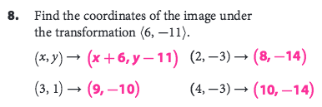
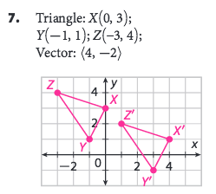
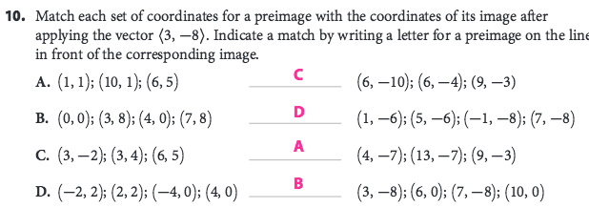

Slide 5
Remember: we are learning about rigid motions!
Translations
Rotations
Reflections
These transformations preserve size and shape!

Slide 6
The SIMPLIEST way to draw a reflection…
Draw a triangle on your patty paper.
Draw a line somewhere near the triangle.
FOLD the paper along the line and trace the triangle onto the other side.
You have just performed a reflection!

Slide 7
To get us in the reflection mood…
https://www.youtube.com/watch?v=FZ4zTXHqGBw

Slide 8
How can we draw a reflection?
VOLUNTEER to come up to the board and draw the image of the triangle? You may use any tools you would like to help you be as exact as you can.

Slide 9
How about this one?

Slide 10
IMPORTANT IDEA:
In a reflection, each vertex of the preimage is the same distance away from the line of reflection as its corresponding vertex in the image

Slide 11
ALSO IMPORTANT:
These “connecting lines” MUST be drawn perpendicular to the line of reflection.

Slide 12
One more…

Slide 13
How does this look on GRAPH PAPER???
How do we know that we drew our connecting lines perpendicular?
How could we prove mathematically that the transformation was a rigid motion?

Slide 14
Perpendicular Lines in the Coordinate Plane
If a line has a slope of , then the slope of a perpendicular line is .
The ratios and are called opposite reciprocals.

Slide 15
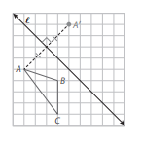
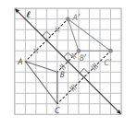
Pg. 844 A

Slide 16
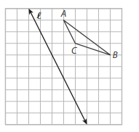
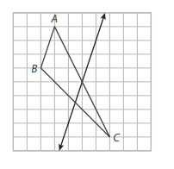

Slide 18
Special types of reflections…
These reflections are very common:
Reflect across the x-axis
Reflect across the y-axis
Reflect across the line y = x
Reflect across the line y = -x
Let’s look at each one a little more closely.

Slide 19
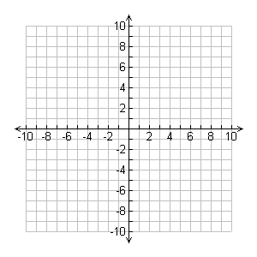
Reflecting across the x-axis:

Slide 20
Reflecting across the x-axis
When you reflect across the x-axis, you are performing this transformation in coordinate notation:
(x, y) → (x, -y)

Slide 21
Reflecting across the y-axis:

Slide 22
Reflecting across the y-axis
When you reflect across the y-axis, you are performing this transformation in coordinate notation:
(x, y) → (-x, y)

Slide 23
Reflecting across the line y = x

Slide 24
Reflecting across the line y = x
When you reflect across the line y = x, you are performing this transformation in coordinate notation:
(x, y) → (y, x)

Slide 25
Reflecting across the line y = -x

Slide 26
Reflecting across the line y = -x
When you reflect across the line y = -x, you are performing this transformation in coordinate notation:
(x, y) → (-y, -x)

Slide 27
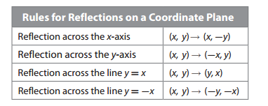
Chart on pg. 846

Slide 28
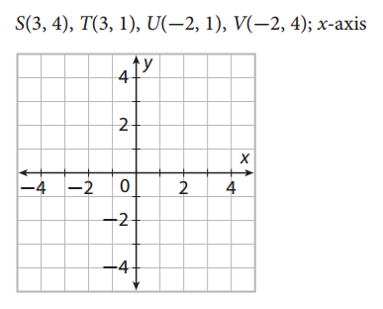
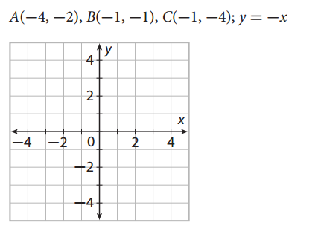
Now try:

Slide 29
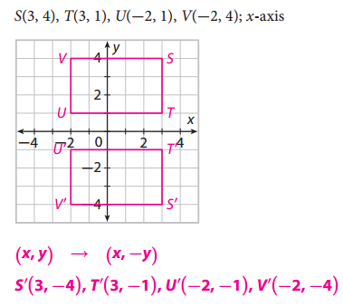
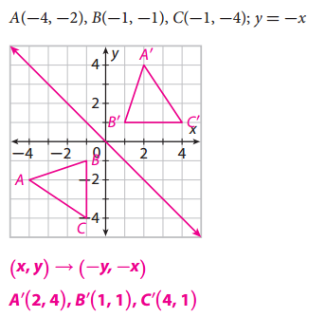

Slide 30
Finding the line of reflection
Who thinks they can draw it???
A
A’
B
C
C’
B’

Slide 31
To find the line of reflection, find the midpoint of each connecting line. Then connect these midpoints.
You can always use the midpoint formula to find the midpoints (like in p. 847 Example A), but a lot of times you will be able to find the midpoint by counting squares.

Slide 32
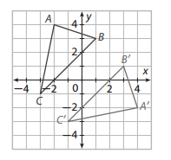
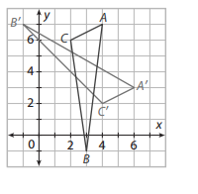

Slide 33
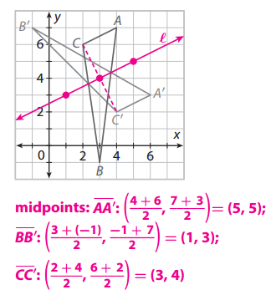
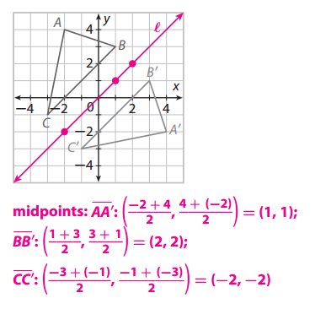

Slide 34
Real-World Application That Will Allow You To Be Really Good At Mini-Golf Or Pool Or Anything Else Where You Have To Bounce A Ball Off A Wall

Slide 35
H’

Slide 36
YOU TRY: p.850 (15)

Slide 37
Homework:
p.851 (1 – 12) use a ruler on 1 – 4

