Slide 1
Quiz Monday! All Exponent Rules

Slide 2
GO OVER HOMEWORK

Slide 3
Negative Exponents continued…
Remember: Mathematicians say to never leave negative exponents or zero exponents in your answer!

Slide 4

Division and Negative Exponents
1. $\frac{15x^{2}}{45x^{7}}$
2. $\frac{16y}{32y^{8}}$
3. $\frac{20z^{25}}{4z^{25}}$
4. $\frac{100{xy}^{2}}{5{xy}^{40}}$

Slide 5

What about:
$$\frac{1}{x^{−5}}$$

Slide 6
Simplify using the zero & negative exponent properties.
$$\frac{{10s}^{−3}}{5t^{−5}}$$
$\frac{{4fg}^{−3}}{16x^{−5}}$
$\frac{{2x}^{−3}y^{−2}}{16w^{0}z^{−3}}$

Slide 7
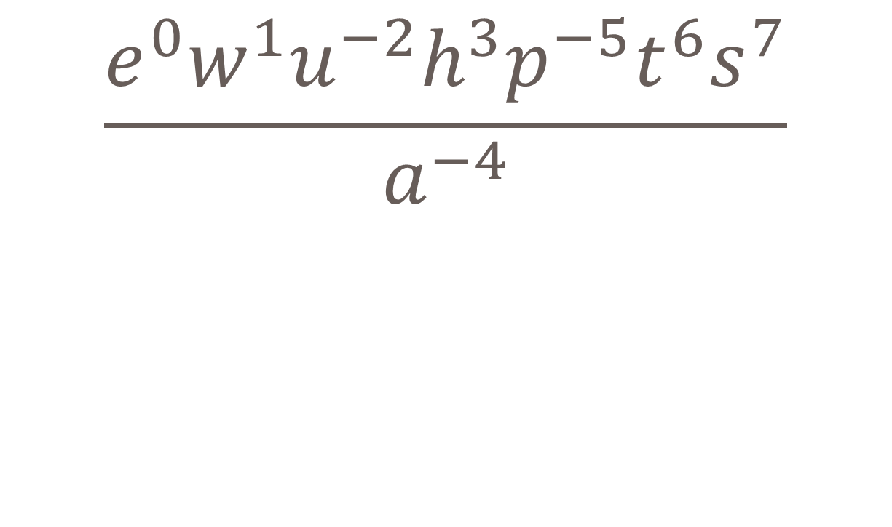
$$\frac{e^{0}w^{1}u^{−2}h^{3}p^{−5}t^{6}s^{7}}{a^{−4}}$$

Slide 8
Find the perimeter and area of the square:
5a⁴

Slide 9
Manny has four pieces of carpet. Each piece is in the shape of a square like the one shown:
He is going to put these four pieces together in a grid like shown:
What is the area of the space he can cover with the carpet?
2x² yd

Slide 10
Whiteboard Review! Simplify using exponent rules. Remember to get rid of all negative and zero exponents!

Slide 17
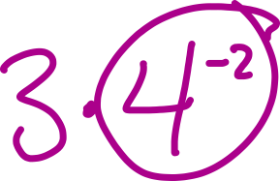

Slide 18
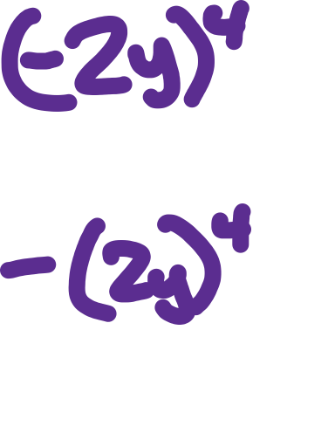

Slide 19
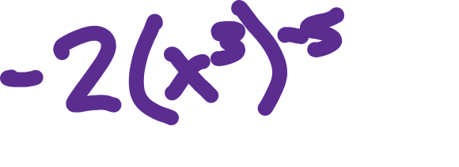

Slide 20
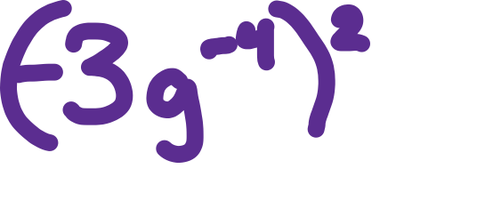

Slide 23
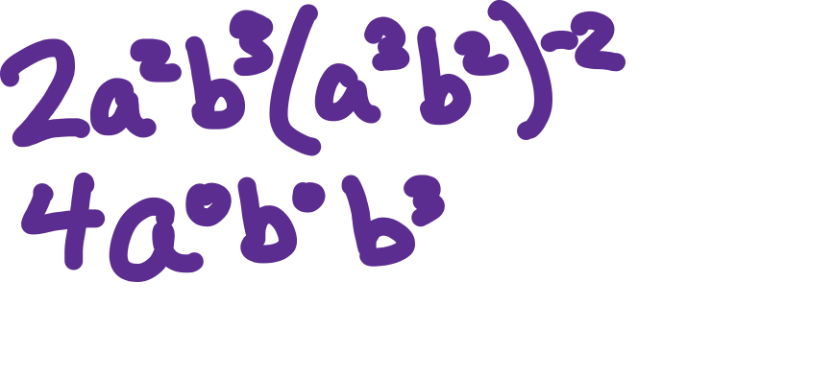

Slide 24
Come up with One for your Partner to Solve!

Slide 25
Homework
Worksheet

