Slide 1
Equations with No Solution or Infinite Solutions
Objective:
-Solve equations that have no solution or infinite solutions

Slide 2
Equations with infinite solutions
In the equation 2x = x + 3, there is only one solution: 3, because 3 is the only number for x that would make both sides equal.
Try to come up with an equation in which every number could work for x.

Slide 3
What value of x makes the equation true?
x + 5 = x + 10
x + 10 = 10 + x
x + x = 2x + 0
2x = 3x
x – 10 = x
2x + 6 = 2(x + 3)
Nothing!
Any number!
Any number!
x = 0
Nothing!
Any number!

Slide 4

What happens with these?
$0x=8$ vs. $8x=0$
$4x=5x$ vs. $4=5$

Slide 5
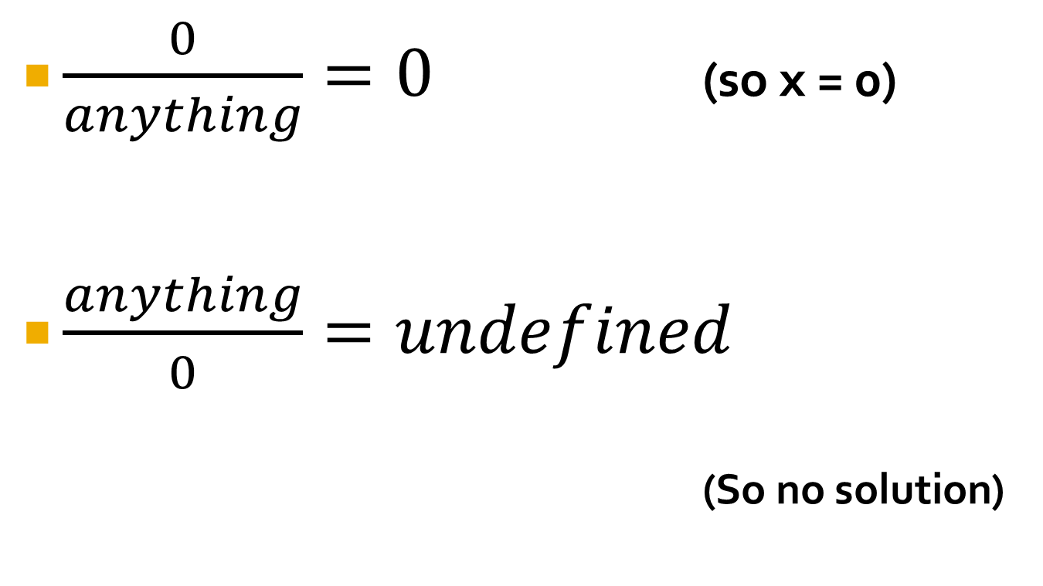
Dividing by zero…
$\frac{0}{anything}=0$ (so x = 0)
$\frac{anything}{0}=undefined$
(So no solution)

Slide 6
What value of x makes the equation true?
2x + 6 = 2(x + 3)
x + 10 = 10 + x
Infinite Solutions
If you ever have the exact same thing on both sides
5 = 5
2x – 8 = 2x – 8
Etc.
Means EVERY NUMBER will work

Slide 7
Important to realize:
If the variables “go away” on BOTH SIDES of the equation, it will either have no solution or infinite solutions.

Slide 8
1 solution, no solutions or infinite solutions?
5(x – 3) + 10 = 2x + 3x – 5
12 = 3(x + 5) - 3x
x + 3 + 3x + 5 = 2x – 4 + 12 + 2x
2(x + 3) = -2x + 6
Infinitely Many Solutions
No Solution
infinitely Many Solutions
x = 0

Slide 9
Homework: “Special” Equations Worksheet

