Slide 1
Objective:
-Solve multi-variable equations for a given variable
Still in “Foundations” section

Slide 2
Introduction Worksheet

Slide 3
Solve for x (get x alone):
x – 7 = 3y
10y = 5x + 25
2y = -8 + 3x

Slide 4
Solve for y (get y alone):
x – 7 = 3y
10y = 5x + 25
2y = -8 + 3x

Slide 5
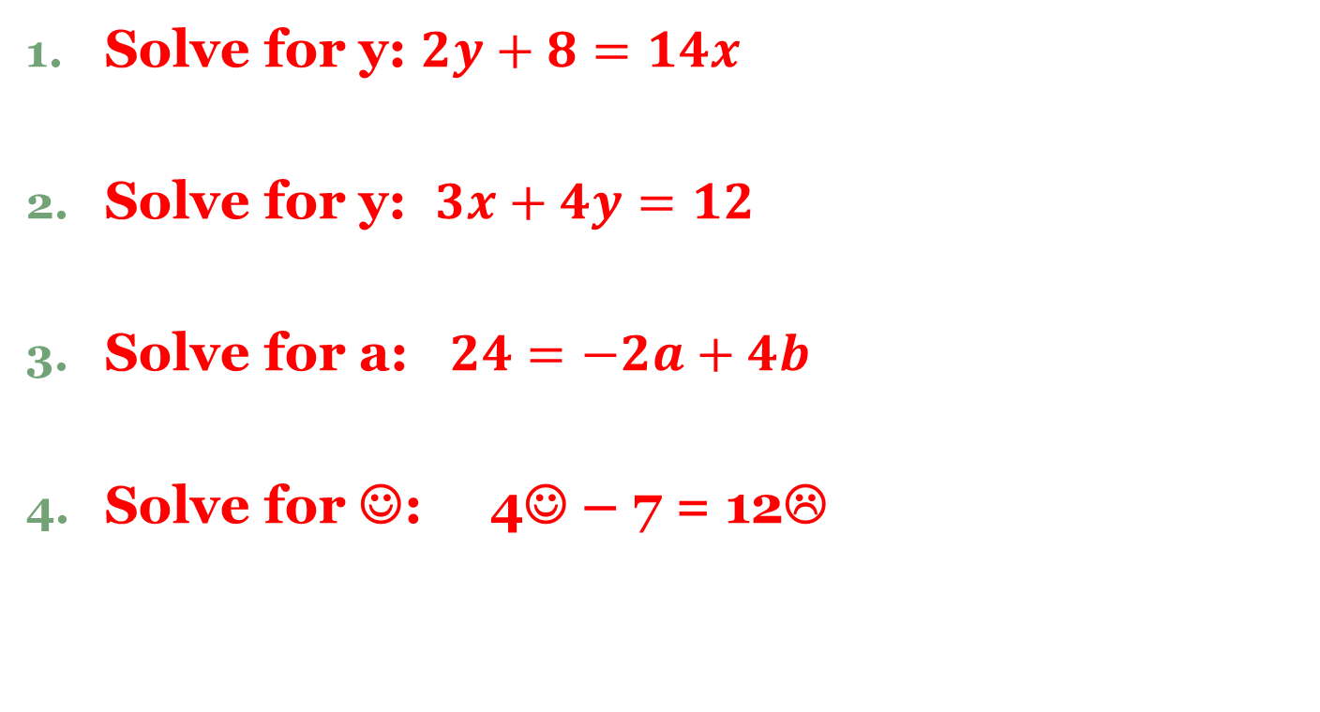
Are we ready for 2-step ones???
Solve for y: $2y+8=14x$
Solve for y: $3x+4y=12$
Solve for a: $24=−2a+4b$
Solve for ☺: 4☺ – 7 = 12☹

Slide 6

Multi-Step
Solve for a: $24=−2a+8a+4b$
Solve for ☺: $\frac{3☺ –3}{2}$= 6☹

Slide 7
Temperature Conversions
You convert from Celsius to Fahrenheit using the formula
$F= \frac{9}{5}C+32$
How do you convert from Fahrenheit to Celsius?

Slide 8
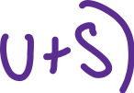
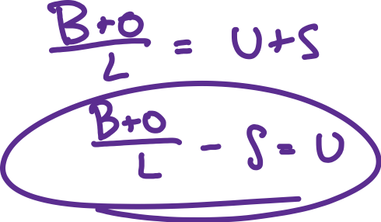

Slide 9
Homework
Worksheet

