Slide 1
GRAB A WHITEBOARD, Marker, and Eraser

Slide 2
For 1-3, say which congruence shortcut you can use. If none, write none!
Can you prove the triangles congruent using the given information?
SAS
ASA
none
AAS

Slide 6
What is the difference?
Between SAS and SSA?
Between ASA and AAS?

Slide 7
SSS, SAS, ASA, AAS, HL or none?
ASA

Slide 8
SSS, SAS, ASA, AAS, HL or none?
SSS

Slide 9
SSS, SAS, ASA, AAS, HL or none?
none

Slide 10
SSS, SAS, ASA, AAS, HL or none?
AAS

Slide 11
SSS, SAS, ASA, AAS, HL or none?
SAS

Slide 12
SSS, SAS, ASA, AAS, HL or none?
none

Slide 13
Sometimes, there is more information than what is given in the diagram…

Slide 14
What can you add to the diagram? State the reason.

Slide 15
What can you add to the diagram? State the reason.

Slide 16
What can you add to the diagram? State the reason.
C is the midpoint of segment BD.

Slide 17
What can you add to the diagram? State the reason.
FH bisects angle GHI.

Slide 18
What can you add to the diagram? State the reason.
M is the midpoint of JL and NK.

Slide 19
What can you add to the diagram? State the reason.

Slide 20
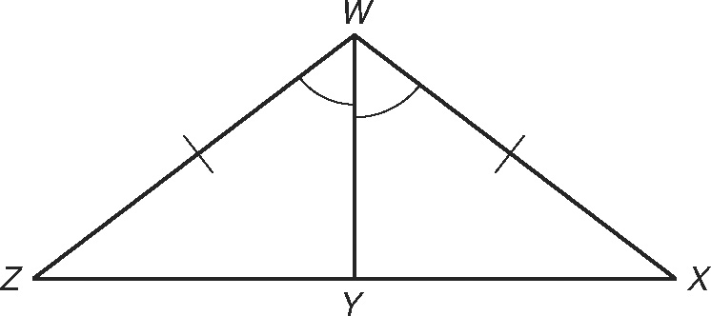

Slide 21
MP bisects ∠NMQ and ∠NPQ.

Slide 22
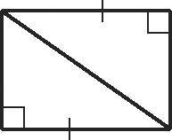

Slide 23
PB and J TIME!
With your table group, I want you to write out the instructions for how to make a PB and J with the items provided. You will have 3 minutes to write down your instructions.

Slide 24
PB and J Time!
Similar to writing instructions for a PB and J, you need to include all details in a proof, even ones that seem obvious!!

Slide 25
What’s the difference between a proof and what we have been doing?
In a proof, you must justify each step.
You need to state what you know, and why you know it.

Slide 26
Copy this down in your notes! You will use these properties as justification!
Properties of Equality
Reflexive Property of Equality | a = a
Symmetric Property of Equality | If a = b then b = a
Transitive Property of Equality | If a = b and b = c then a = c

Slide 27
Highlight pg. 911

Slide 28

Prove: $∆ABC≅∆EDC$
E
B
C
D
A
Which one do you want to see first?
Paragraph proof
Two-column proof
Flow-chart proof

Slide 29
Paragraph Proof
Just write, using complete sentences, a logical argument that proves what you want to prove. For everything you state, you must say how you know it.

Slide 30
Paragraph Proof
E
B
C
Prove: $∆ABC≅∆EDC$
We know $\overline{AB}≅\overline{ED}$ because it is given. We also know that $∠A≅∠E$ because it is given. In addition, $∠BCA≅∠DCE$ because they are vertical angles. Thus, $∆ABC≅∆EDC$ by AAS.
D
A

Slide 31
Two-Column Proof
Organizes your proof into columns. One column is for your statements, and the other one is for your reasons. The last statement will always be the one you are trying to prove.

Slide 32
Two-Column Proof
E
B
C
Prove: $∆ABC≅∆EDC$
D
A
Statement
1) ___________
2) ___________
3) ___________
4) ___________
Reason
1) ___________
2) ___________
3) ___________
4) ___________
A
A
S
$$∠A≅∠E$$
Given
$$∠BCA≅∠DCE$$
Vertical Angles Thm.
$$\overline{AB}≅\overline{ED}$$
Given
$$∆ABC≅∆EDC$$
AAS

Slide 33
Flow Chart Proof
A visual depiction of your proof. Each “bubble” will have a statement and a reason in it. You draw arrows to show which statements lead to which other statements.

Slide 34
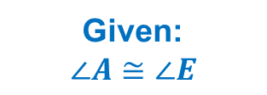
Flow-Chart Proof
E
B
C
Prove: $∆ABC≅∆EDC$
D
A
Given:
$$∠A≅∠E$$
Vertical Angles Thm:
$$∠BCA≅∠DCE$$
AAS
$$∆ABC≅∆EDC$$
Given:
$$\overline{AB}≅\overline{ED}$$

Slide 35
Given: K is the midpoint of $\overline{JL}$.
Prove: $∆JKM≅∆LKM$
M
J
L
K

Slide 36

Two-Column Proof
M
Given: K is the midpoint of $\overline{JL}$.
Prove: $∆JKM≅∆LKM$
J
K
L
Statement
1) ___________
2) ___________
3) ___________
4) ___________
5) ___________
Reason
1) ___________
2) ___________
3) ___________
4) ___________
5) ___________
$$\overline{MK}≅\overline{MK}$$
Reflexive Property
$$∠JKM≅∠LKM$$
Given
K is the midpoint of $\overline{JL}$
Given
$$\overline{JK}≅\overline{LK}$$
Definition of midpoint
$$∆JKM≅∆LKM$$
SAS

Slide 37
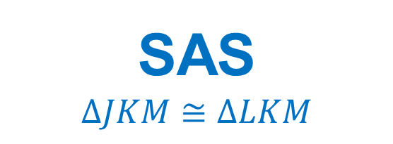
Flow-Chart Proof
M
Given: K is the midpoint of $\overline{JL}$.
Prove: $∆JKM≅∆LKM$
J
K
L
Reflexive Prop.
$$\overline{KM}≅\overline{KM}$$
Given:
$$∠JKM≅∠LKM$$
SAS
$$∆JKM≅∆LKM$$
Given:
$$\text{K} \text{is} \text{the}$$
$$\text{midpoint} \text{of} \overline{JL}$$
Def. of midpoint:
$$\overline{JK}≅\overline{LK}$$

Slide 38

On your giant whiteboards, write a proof:
P
Given: $\overline{QR}$ bisects$∠PQS$.
Prove: $∆PQR≅∆SQR$
Q
R
S

Slide 39

On your giant whiteboards, write a proof:
Prove: $∆WXY≅∆YZW$
W
X
Z
Y

Slide 40

On your giant whiteboards, write a proof:
B
Given: $\overline{AB}∥$ $\overline{DE}$
Prove: $∆ABC≅∆EDC$
E
C
A
D

