Slide 1
Warm Up
Giant Whiteboard
Find the missing angle measure.
Find all angle measures.
75º
65º
79º
(2x+35)º
85º
135°
(x+25)º
xº
87º
119°
75°

Slide 2
Objective:
Identify properties of parallelograms

Slide 3
What is a parallelogram?
a quadrilateral with opposite sides parallel

Slide 4
Exploration: Parallelograms
Come up with a list of as many additional properties as you can about parallelograms.

Slide 5
What is true about the sides of a parallelogram?
What is true about the angles of a parallelogram?
Did anyone draw the diagonals through the middle and look at those?

Slide 6
Which sides are opposite sides?
Which angles are opposite angles?
Which angles are consecutive angles?
What are diagonals?
F
O
R
U

Slide 7
Parallelograms
Opposite sides parallel
Opposite sides congruent
Opposite angles congruent
Consecutive angles are supplementary
Diagonals bisect each other

Slide 8
Let’s prove these properties!

Slide 9
(Prove that opposite sides are congruent)

Slide 11
(Prove that opposite angles are congruent)

Slide 13
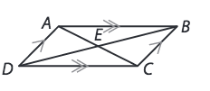
(Prove that diagonals bisect each other)

Slide 14
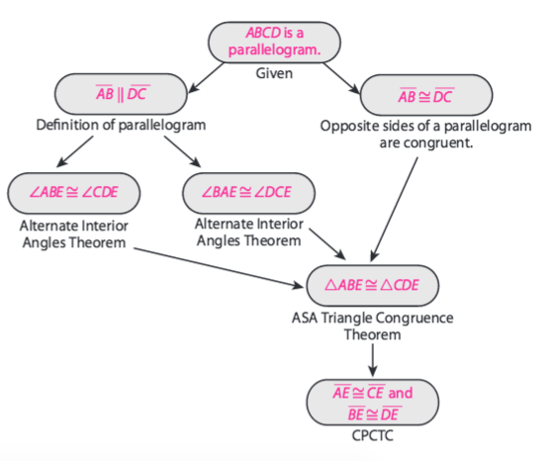

Slide 15
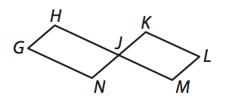

Slide 17
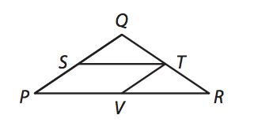

Slide 18
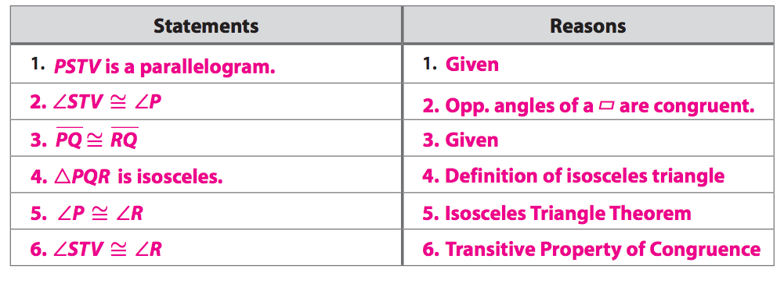

Slide 19
Classwork
pg. 1198 (10-13)

Slide 21
Homework
p.1197-1199 (6-9, 16-18, 24)

