Slide 1
Welcome to Miss Niemiec’s Class!

Slide 2
Schedules!

Slide 3
About Me
I am from Cleveland, Cincinnati, and San Antonio.
Went to college at Vanderbilt University
Majored in Math and Secondary Education
4th year at Meigs!

Slide 4
Goals for the year!
Have a growth mindset!
Learn how to problem solve
Learn how to become more fluent in the language of math
Think and make wise decisions

Slide 5
Growth mindset

Slide 6
Growth mindset

Slide 7
Homework
Students will have homework around 3 times a week and the majority of it will come from their textbook.
Homework is worth 10% of their grade and I will grade some homework assignments on completion and some on accuracy.
Students also need to complete 75% of their homework assignments in order to be eligible for Reward Day.

Slide 8
ALEKS
Students will also have to complete 30 minutes of ALEKS each week, as part of their homework grade. I try to give students 30 minutes of class time on Mondays to complete their ALEKS but if they do not finish, they will have to complete it on their own time.
Students can find information on how to access ALEKS on my website if they forget.
Students can use the same ALEKS login information to access their online textbook. If they ever forget their textbook at school and have homework that evening, they can always go online and get the homework questions.

Slide 9
Grades
Summative Assessments
Students will know about these at least a week in advance.
Summative assessments will make up the remainder of a students’ average.
Retakes will be available for every summative assessment.
Students will typically have two weeks to prepare for a retake and after those two weeks, there will not be an opportunity for them to retake their assessment.

Slide 10
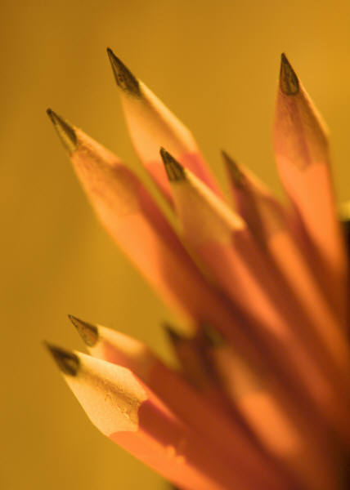
Standardized Test
Taken on the Computer
Given in one part with three sections in May
Calculator and Non-Calculator Sections
More information to come?

Slide 11
My Website
www.niemiecmath.weebly.com/
I will post weekly updates on what we will be learning for that week and handouts we use in class

Slide 12
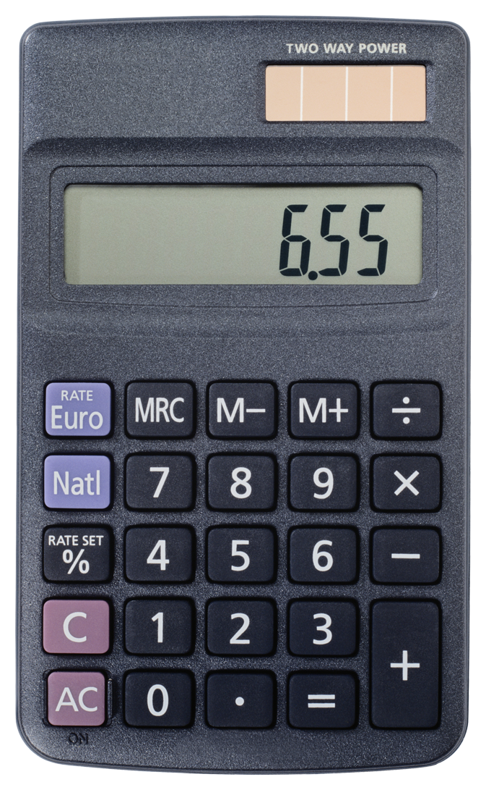
FAQs
Calculators
Wait until Hume Fogg
Homework
Homework is worth 10% of the grade
Tutoring
Tuesdays and Thursdays during lunch
Before/After School with
advanced notice!

Slide 13
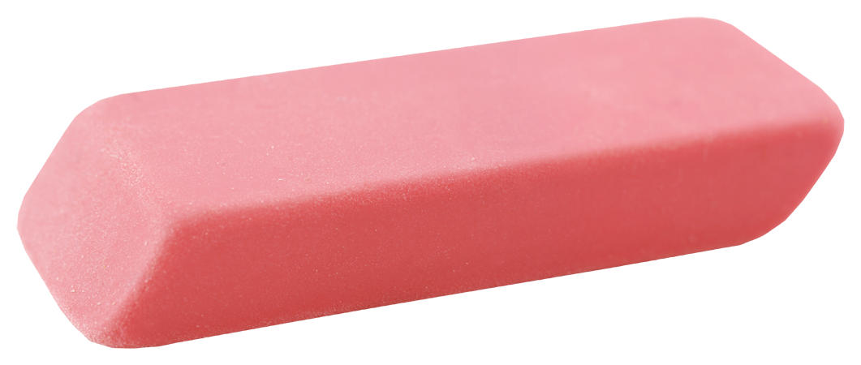
How do I help my child learn?
Ask them about what they are learning- have them teach you!
Help them learn good study skills
Help them keep organized and learn to be responsible
It’s ok to make mistakes!

Slide 14
How do I help Miss Niemiec?
Please donate tissue boxes, Clorox Wipes, or Expo markers!

Slide 15
THANK YOU!!!

Slide 16
Questions?

