Slide 1
Worksheet Answers
1. a = 60, b = 120, c = 120
2. a = 90, b = 90, c = 50
3. a = 77, b = 52, c = 77, d = 51
4. a = 60, b = 120, c = 120, d= 115, e = 65,
f =115, g = 125, h =55, I =125
5. a = 90, b = 163, c = 17, d = 110, e = 70
6. They should add up to 180 degrees.

Slide 2
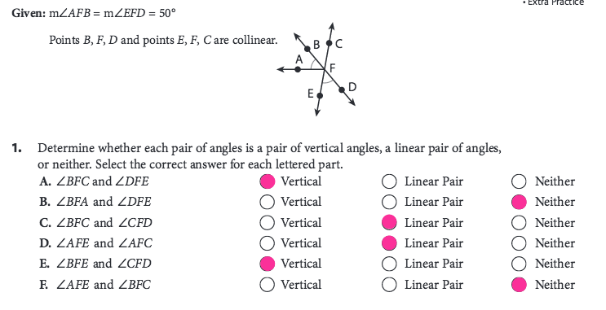

Slide 4
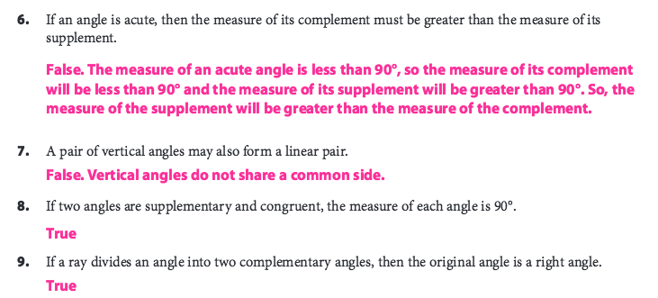

Slide 5
Angles formed by Parallel Lines
Objectives:
Given one angle measure, find ALL angles formed by 2 parallel lines
Identify special angle pairs
Use special angle pair rules to find angle measures

Slide 6
TRANSVERSAL: A line that intersects two coplanar lines.

Slide 7
Corresponding Angles
Two angles that are in the same “position” but on different lines are called corresponding.
1
2

Slide 8
New terminology
Which angles would you say are interior angles?
Which angles would you say are exterior angles?
1
2
3
4
5
6
7
8

Slide 9
New terminology
Interior: between the lines
Exterior: outside the lines
Alternate: opposite sides of the transversal
Same-side: same side of the transversal
Give me an example of:
A pair of alternate interior angles
A pair of same-side interior angles
A pair of alternate exterior angles
1
2
3
4
5
6
7
8

Slide 10
IN YOUR NOTES!
Alternate Interior: 4 and 5, 3 and 6
Same-side Interior: 3 and 5, 4 and 6
Alternate Exterior: 1 and 8, 2 and 7
Corresponding: 1 and 5, 2 and 6, 3 and 7, 4 and 8
1
2
3
4
5
6
7
8

Slide 11
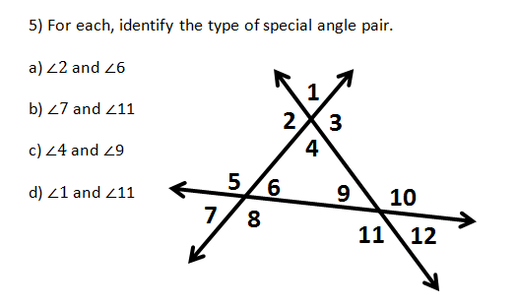

Slide 12
Corresponding Angles
If the lines are parallel, corresponding angles will be congruent!!!
1
1
2
2

Slide 13
DISCUSS WITH YOUR GROUP:
If lines m and n are parallel, which angles are congruent to each other?
Discuss in groups:
Which angles do you think are congruent?
Why do you think they are congruent?
Does your group all agree or not?
WHAT IS THIS SYMBOL????
l
1
2
3
4
m
5
6
n
7
8

Slide 14
Same Side Interior Angles Postulate:
If two parallel lines are cut by a transversal, then the pairs of same-side interior angles are supplementary
Corresponding Angles Theorem
If two parallel lines are cut by a transversal, then the pairs of corresponding angles have the same measure

Slide 15
Alternate Interior Angles Theorem:
If two parallel lines are cut by a transversal, then the pairs of alternate interior angles have the same measure
Alternate Exterior Angles Theorem:
If two parallel lines are cut by a transversal, then the pairs of alternate exterior angles have the same measure

Slide 16
IN YOUR BINDER
IF THE LINES ARE PARALLEL:
Alternate Interior: congruent
Alternate Exterior: congruent
Same-side Interior: supplementary

Slide 17
One angle measure is given. Find the measures of ALL other angles.
1
35º
2
3
4
5
6
7

Slide 18
One angle measure is given. Find the measures of ALL other angles.
3
4
2
7
1
98º
5
6

Slide 19
Which type of angle?
1
2

Slide 20
Which type of angle?
1
2

Slide 21
Which type of angle?
2
1

Slide 22
Which type of angle?
1
2

Slide 23
Which type of angle?
1
2

Slide 24
Which type of angle?
1
2

Slide 25
Which type of angle?
1
2

Slide 26
Which type of angle?
1
2

Slide 27
Which type of angle?
1
2

Slide 28
Which type of angle?
1
2

Slide 29
Which type of angle?
Corresponding
1
2

Slide 30
Which type of angle?
Same-side interior
1
2

Slide 31
Which type of angle?
Corresponding
1
2
WHY ARE THERE TWO ARROWS???

Slide 32
What is ALWAYS true about alternate interior angles when two parallel lines are cut by a transversal?
5
1
2
3
4
They are congruent

Slide 33
What is ALWAYS true about same-side interior angles when two parallel lines are cut by a transversal?
1
2
3
4
They are supplementary

Slide 34
What is ALWAYS true about alternate exterior angles when two parallel lines are cut by a transversal?
1
2
5
3
4
They are congruent

Slide 35
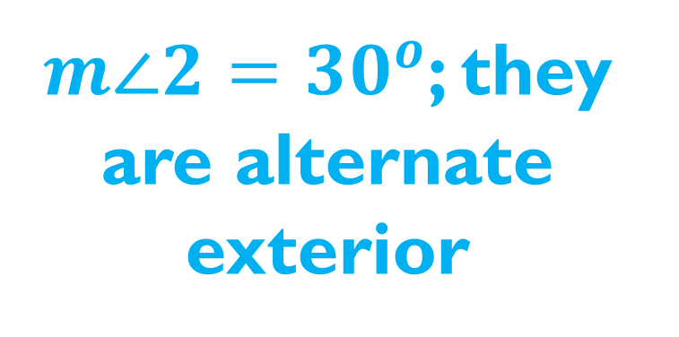
If the measure of angle 1 is 30 degrees, what is the measure of angle 2? HOW DO YOU KNOW?
$m∠2={30}^{o}$; they are alternate exterior
1
2

Slide 36
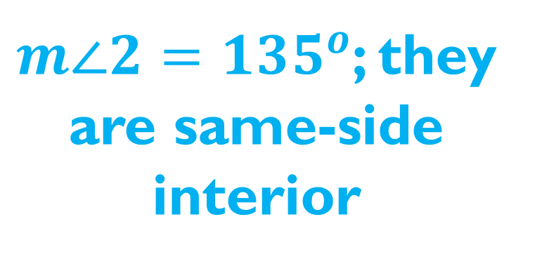
If the measure of angle 1 is 45 degrees, what is the measure of angle 2? HOW DO YOU KNOW?
$m∠2={135}^{o}$; they are same-side interior
1
2

Slide 37
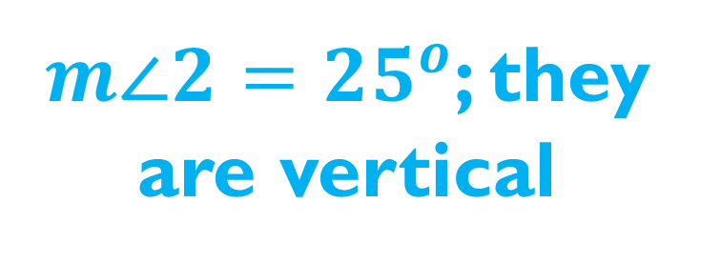
If the measure of angle 1 is 25 degrees, what is the measure of angle 2? HOW DO YOU KNOW?
$m∠2={25}^{o}$; they are vertical
1
2

Slide 38
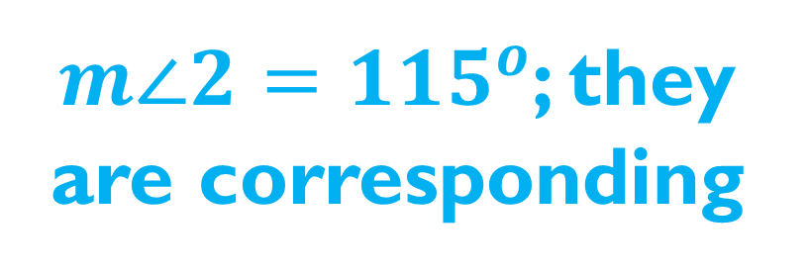
If the measure of angle 1 is 115 degrees, what is the measure of angle 2? HOW DO YOU KNOW?
$m∠2={115}^{o}$; they are corresponding
1
2

Slide 39
If the measure of angle 1 is 47 degrees, what is the measure of angle 2? HOW DO YOU KNOW?
$m∠2={47}^{o}$; they are alternate interior
1
2

Slide 40
If the measure of angle 1 is 41 degrees, what is the measure of angle 2? HOW DO YOU KNOW?
$m∠2={139}^{o}$; they are supplementary
1
2

Slide 41
If the measure of angle 1 is 41 degrees, what is the measure of angle 2? HOW DO YOU KNOW?
1
TRICK QUESTION: These lines aren’t parallel. We don’t know!
2

Slide 42

If the measure of angle 1 is 40 degrees, what is the measure of angle 2? HOW DO YOU KNOW?
$m∠2={140}^{o}$; angle 3 is 40 degrees because it corresponds to angle 1; angle 2 is supplementary with angle 3
1
3
2

Slide 43
With algebra…
Find the value of x.
Alt. Ext: congruent
2x + 50 = 4x – 10
x = 30
(4x – 10)º
(2x +50)º

Slide 44
With algebra…
Find the measure of both angles.
Same-side interior: supplementary
(5x) + (x + 30) = 180
6x +30 = 180
x = 25
(5x)º
55º , 125º
(x + 30)º

Slide 45
Exit Ticket
1
2
Don’t forget your name
Hold it up when done
If $m∠1={84}^{o}$, find the measure of ALL other angles.
If $m∠3={112}^{o}$, find the measure of angle 6.
If $m∠5={80}^{o}$, find the measure of angle 3.
Angle 4 and angle 8 are _________ angles.
Angle 2 and angle 7 are ________ angles.
3
4
5
6
7
8

Slide 46
Homework
Worksheet

