Slide 1
Check Homework

Slide 2
Quiz Tomorrow
Is it a function?
Function Notation f(x)
Writing a Function and Describe the Independent and Dependent Variables
Function Notation and Graphs

Slide 3
Write a rule in function notation to model the situation. Give the independent and dependent variables:
Amanda babysits and charges $5 per hour.

Slide 4
Write a rule in function notation to model the situation. Give the independent and dependent variables:
An amusement park charges a $5 fee for parking and $30 per person.

Slide 5
Write a rule in function notation to model the situation. Give the independent and dependent variables:
A lawyer’s fee is $180 per hour for his services.

Slide 6
A lawyer’s fee is $180 per hour for his services.
Find f(5). What does it mean in this situation?

Slide 7
Write a rule in function notation to model the situation. Give the independent and dependent variables:
Jenna’s parents have given her an interest-free loan of $100 to buy a new pair of shoes. She plans to pay back the loan with monthly payments of $20 each.

Slide 8
Jenna’s parents have given her an interest-free loan of $100 to buy a new pair of shoes. She plans to pay back the loan with monthly payments of $20 each.
j(x) = 100-20x
Find j(3). What does it mean in terms of the situation?

Slide 9
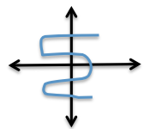
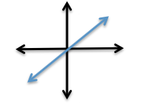
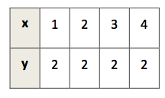
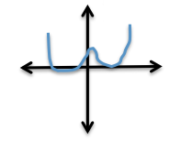
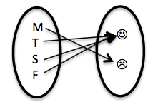
Which are functions?

Slide 10
Function Notation
Work on the Decoding Message Sheet with your Table groups!
Once you are done, you can work on your review sheet!

Slide 11
Homework
Worksheet

