Slide 1
What is a Function?
Objective:
-Be able to tell if something is a function or not

Slide 2
Vocab- write this in your binder
A function is a rule. Each input must only have one output.
Each x value can only be paired with one y value

Slide 3
Function?
x | y
3 | 6
5 | 10
5 | 12
8 | 14
12 | 18
No; the input “5” has more than one output.

Slide 4
Function?
x | y
-8 | 16
10 | -20
1 | -2
4 | -8
1 | -2
Yes; there is a repeated input, but the output is the same.

Slide 5
Function?
x | y
1 | 5
1 | 6
2 | 7
2 | 8
3 | 9
No; the inputs “1” and “2” have more than one output.

Slide 6
Function?
x | y
1 | 24
2 | 9
3 | -6
4 | -21
5 | -36
Yes; each input has only one output.

Slide 7
Function?
x | y
1 | -2
2 | -2
3 | -2
4 | -2
5 | -2
Yes; each input has only one output. (You can have the same output for multiple inputs!)

Slide 8
Function?
(2, 8); (-5, 9); (7, 9); (2, -4), (7, 4)
No; the input “2” has more than one output.

Slide 9
Function?
(1, 5); (8, 19); (4, 11); (-8, -13), (1, 5)
Yes, each input has only 1 output.

Slide 10
Mapping Diagram:
Express the relation (2,0), (5, 9), (-1, 9), (-2, 16) as a mapping diagram.
2
5
-1
-2
0
9
16

Slide 11
Function?
0
8
2
3
6
5
-10
-9
Yes, each input has only 1 output.

Slide 12
Function?
4
5
6
7
2
7
11
25
No; the input “6” has more than one output.

Slide 13
Function?
1
4
7
12
4
Yes, each input has only 1 output.

Slide 14
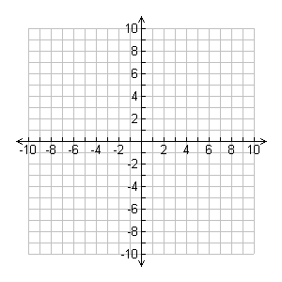
Function? (COPY THIS ONE FOR YOUR NOTES)
No; most x-values have two different y-values

Slide 15
Function? (COPY THIS ONE FOR YOUR NOTES)
Yes

Slide 16
Rules for graphs of functions
ON A GRAPH:
The x-value (horizontal) is the INPUT and the y-value (vertical) is the OUTPUT.
To be a function, each x-value can only have one y-value.

Slide 17
Function?
No

Slide 18
Function?
Yes

Slide 19
Function?
Yes

Slide 20
Function?
No

Slide 21
Function?
Yes

Slide 22
Function?
No

Slide 23
Some graphs are connected lines or curves called continuous graphs. Some graphs are only distinct points. They are called discrete graphs

Slide 24
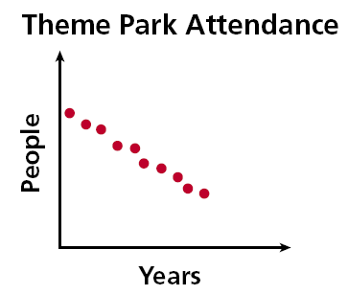
Why is this a Discrete Graph?
The graph on theme park attendance is an example of a discrete graph. It consists of distinct points because each year is distinct and people are counted in whole numbers only. The values between whole numbers are not included, since they have no meaning for the situation.

Slide 25
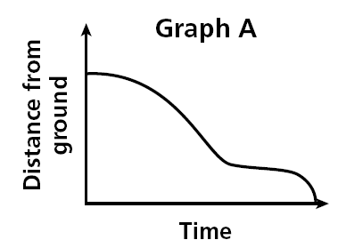
Why is this a Continuous Graph?
The graph models the situation of a child going down a slide. Graph A represents the child’s distance from the ground related to time.

Slide 26
Choosing Graphs to Represent Situations

Slide 27
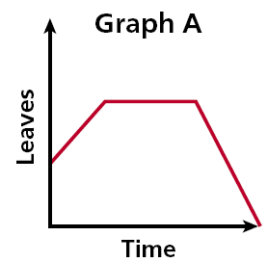
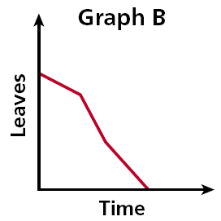
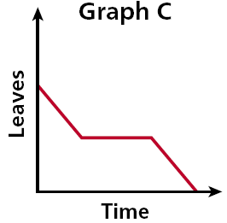
Each day several leaves fall from a tree. One day a gust of wind blows off many leaves. Eventually, there are no more leaves on the tree. Choose the graph that best represents the situation.
Graph B

Slide 28
Function Carnival Activity
student.desmos.com
Class Code: KSVR57
Login with your first name ONLY
THE DARKENED FIGURE IS YOURS, The shaded figure is what it should be

Slide 29
Homework
Worksheet

