Slide 1
Points, Lines, Planes
pg. 775
A point is a specific location. It has no dimension and is represented by a dot.
A line is a connected straight path. It has no thickness and it continues forever in both directions.
A plane is a flat surface. It has no thickness and it extends forever in all directions.

Slide 2
Naming Points
A
C
B
D
H
F
I
G
E
Notes:
Ask a student to pick a point (without the names) and tell another student which point she is talking about. This will be somewhat difficult. Then bring in the names. Repeat.

Slide 3
Lines
A
C
B
D
H
F
I
G
E
Notes:
Ask a student to pick a line and tell another student which line she is talking about. This will be easy.

Slide 4
Naming Lines
A
C
B
D
H
F
I
G
E
Notes:
Talk about how two points is necessary for a line. How you write a line. At this point here we have the sum of Geometry — everything we’ll ever talk about. Points, Lines, Planes. Define: collinear.

Slide 5
Planes
https://www.youtube.com/watch?v=k5etrWdIY6o
Notes:
https://www.youtube.com/watch?v=k5etrWdIY6o

Slide 6
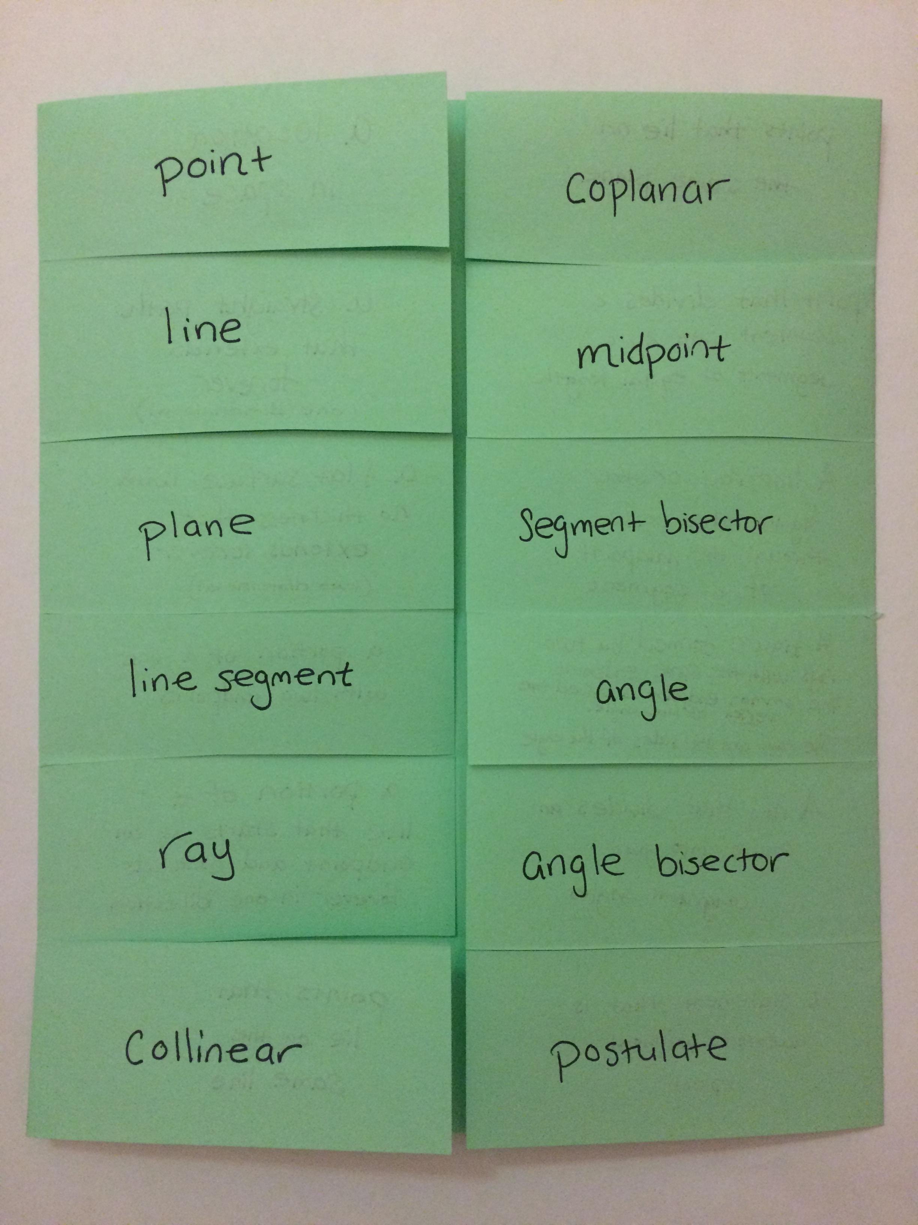

Slide 7
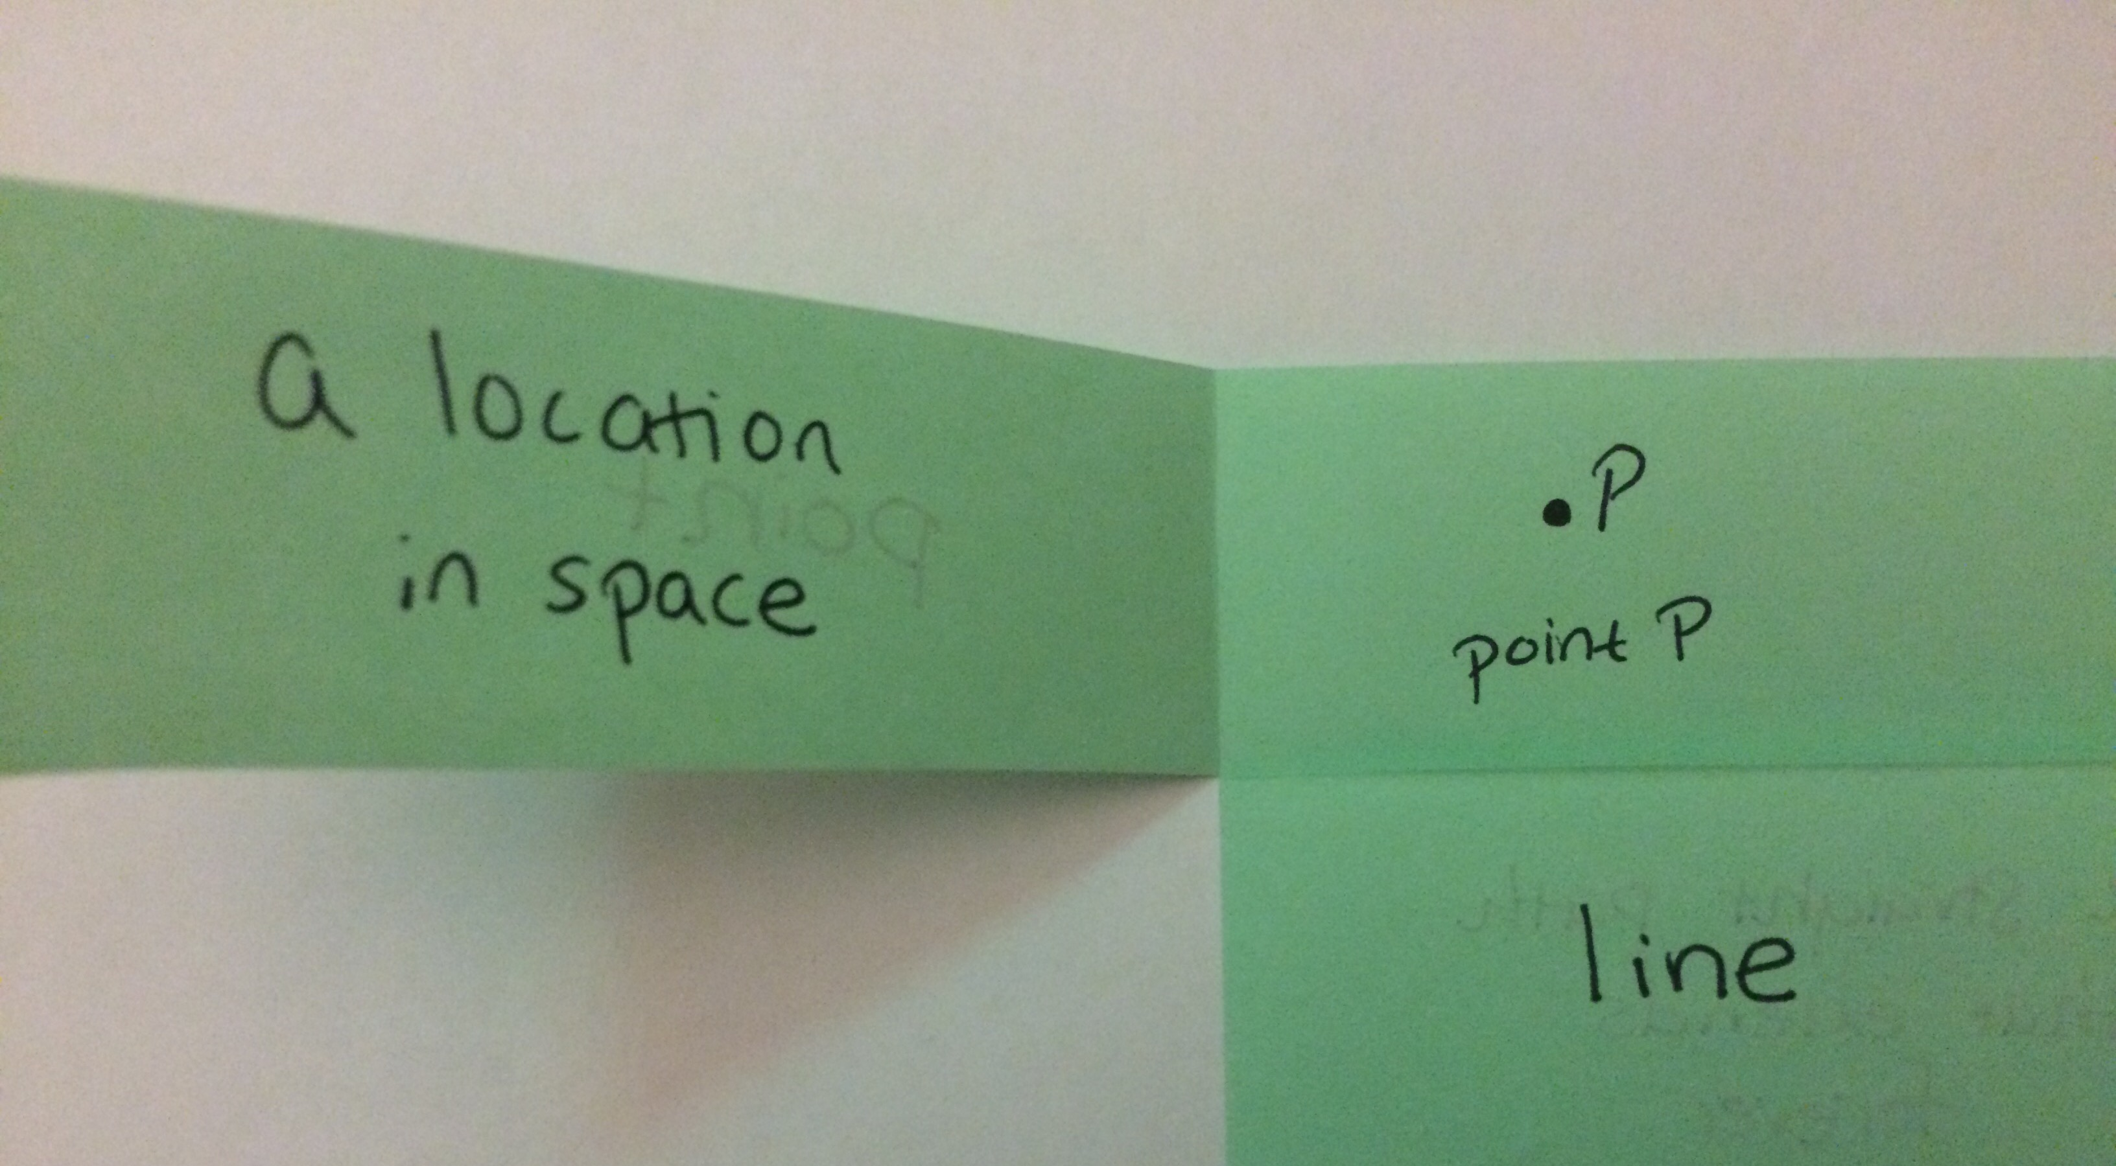
Point

Slide 8
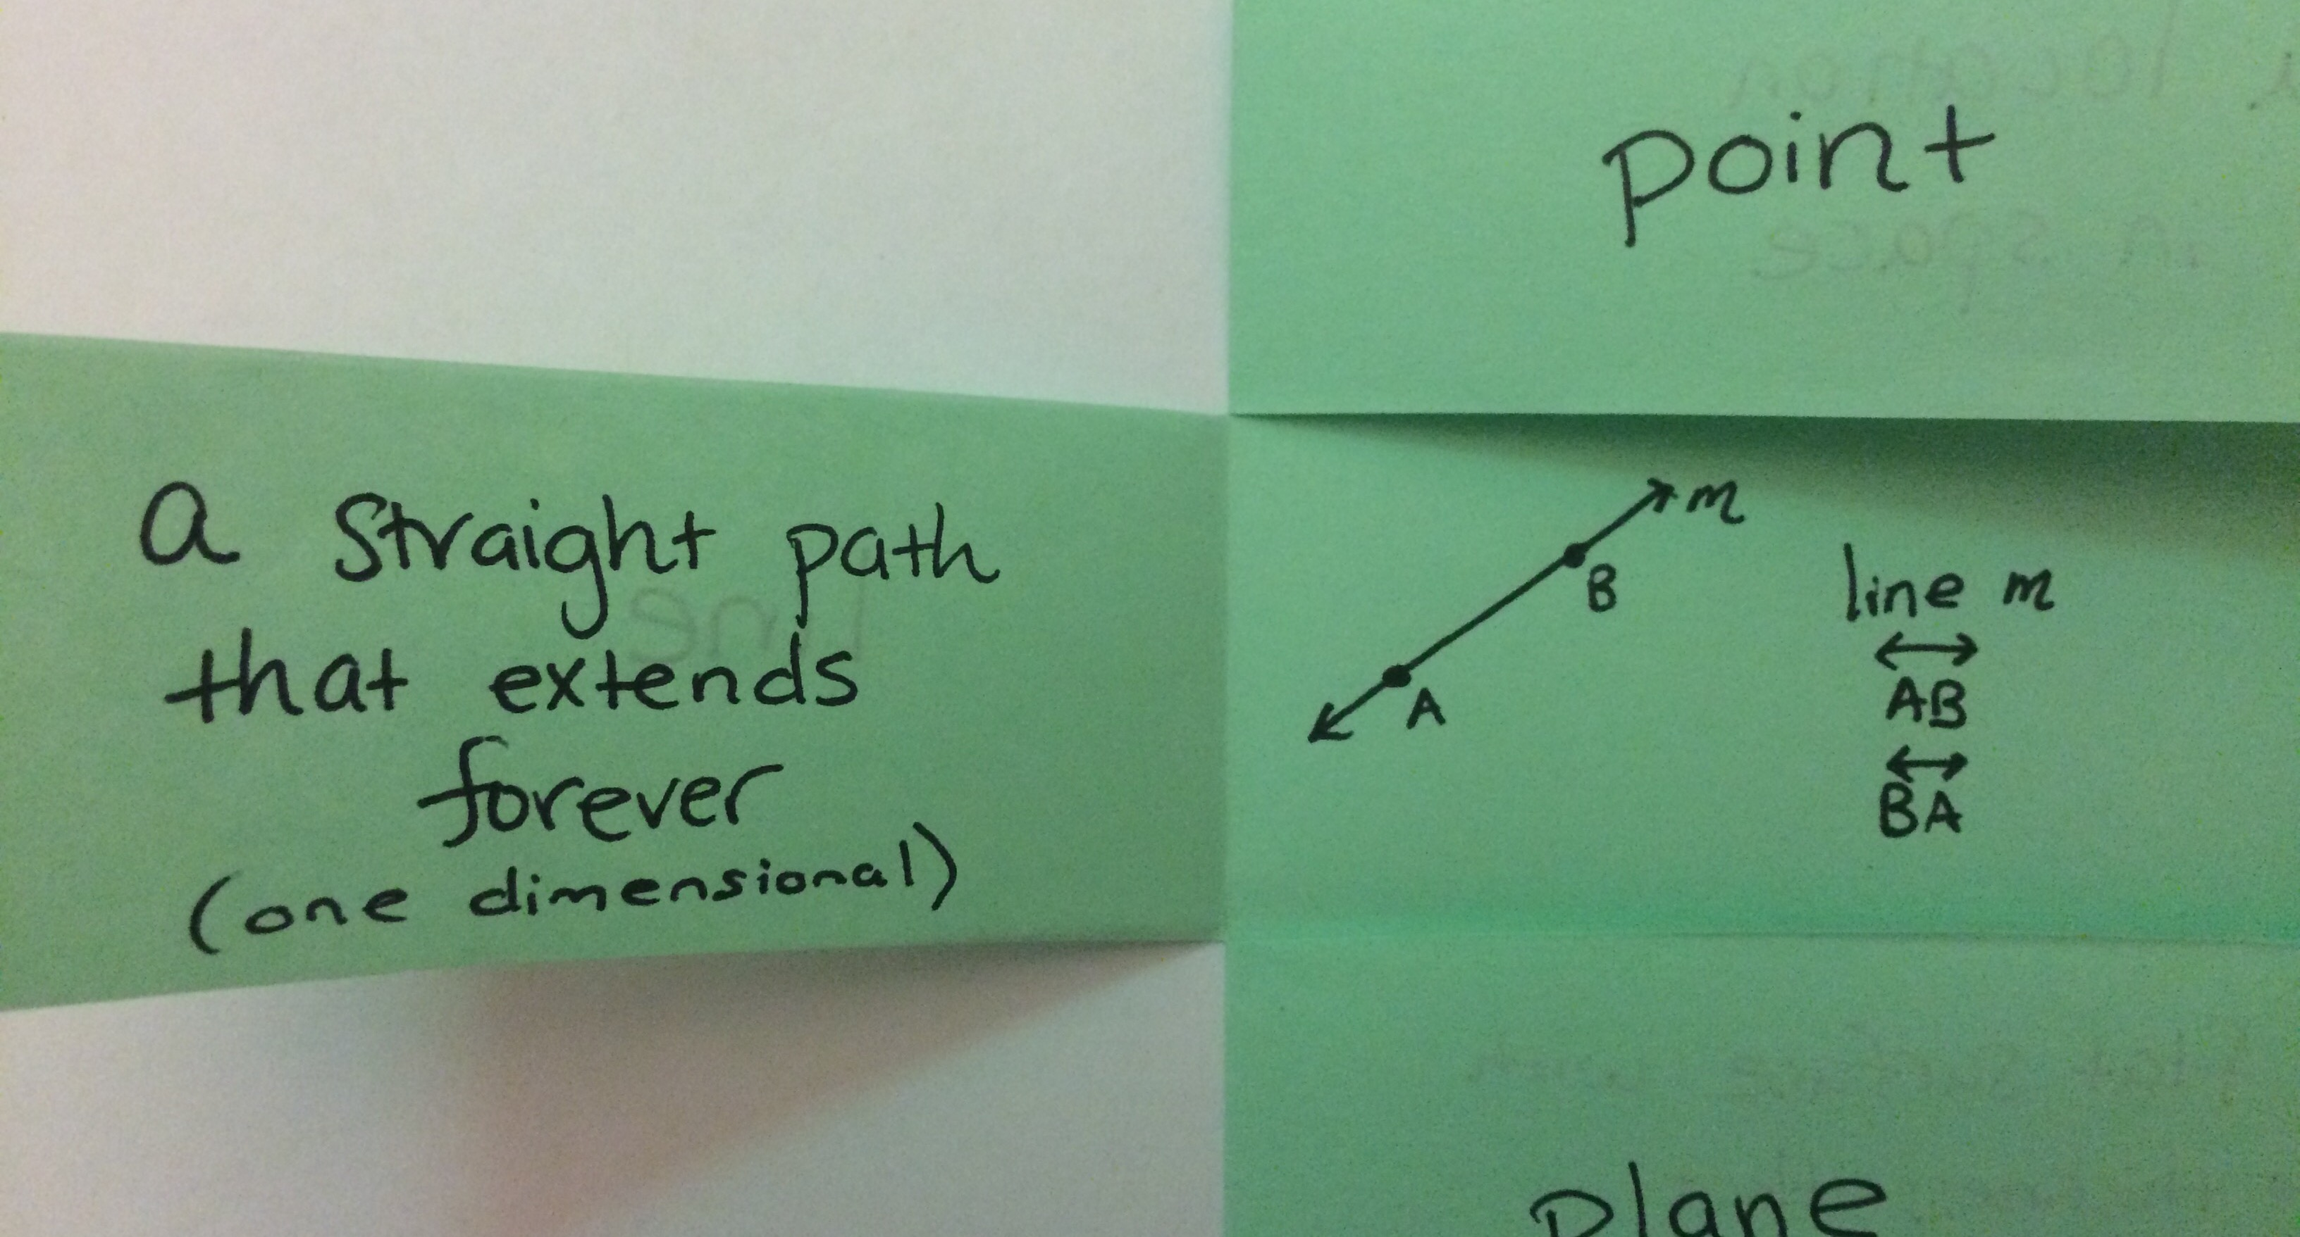
Line

Slide 9
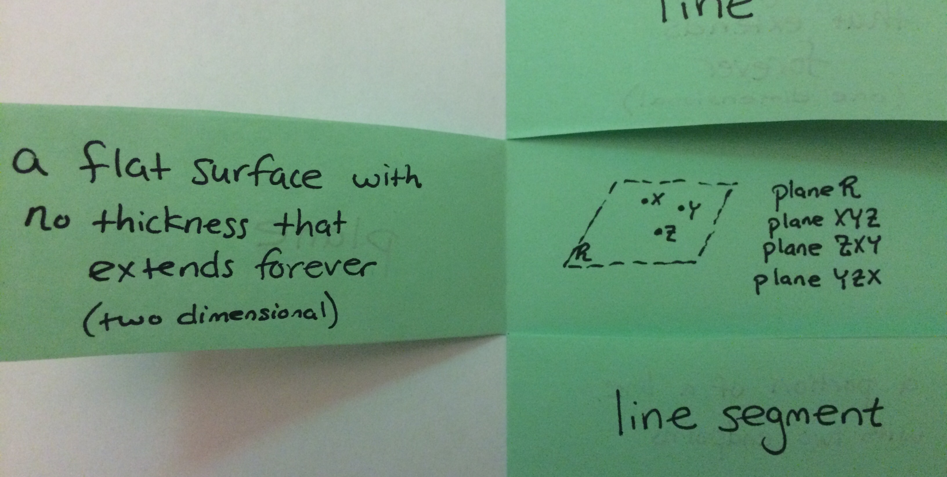
Plane

Slide 10
Undefined Terms
Point, line, and plane are undefined terms. We call them this because they are the most basic terms in Geometry.
They cannot be defined using other terms.

Slide 11
Defined Terms
Now that we know what undefined terms are, what are defined terms?
What is classified as a defined term?
Defined terms are terms that are defined by undefined terms.

Slide 12
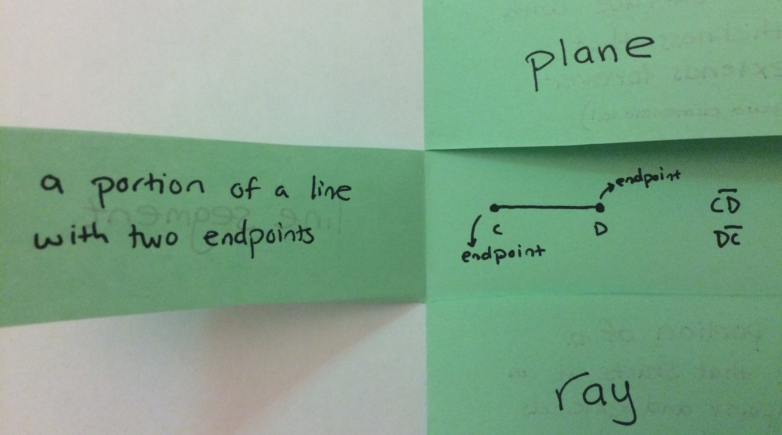
Line Segment

Slide 13
Quick Reflection
A B C
Is $\overline{AB}$ the same as $\overline{AC}$ ?

Slide 14
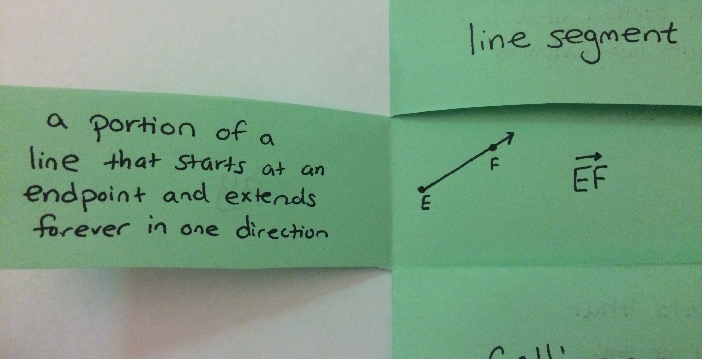
Ray

Slide 15
Quick Reflection
Is $\vec{KJ}$ the same as $\vec{JK}$ ?

Slide 16
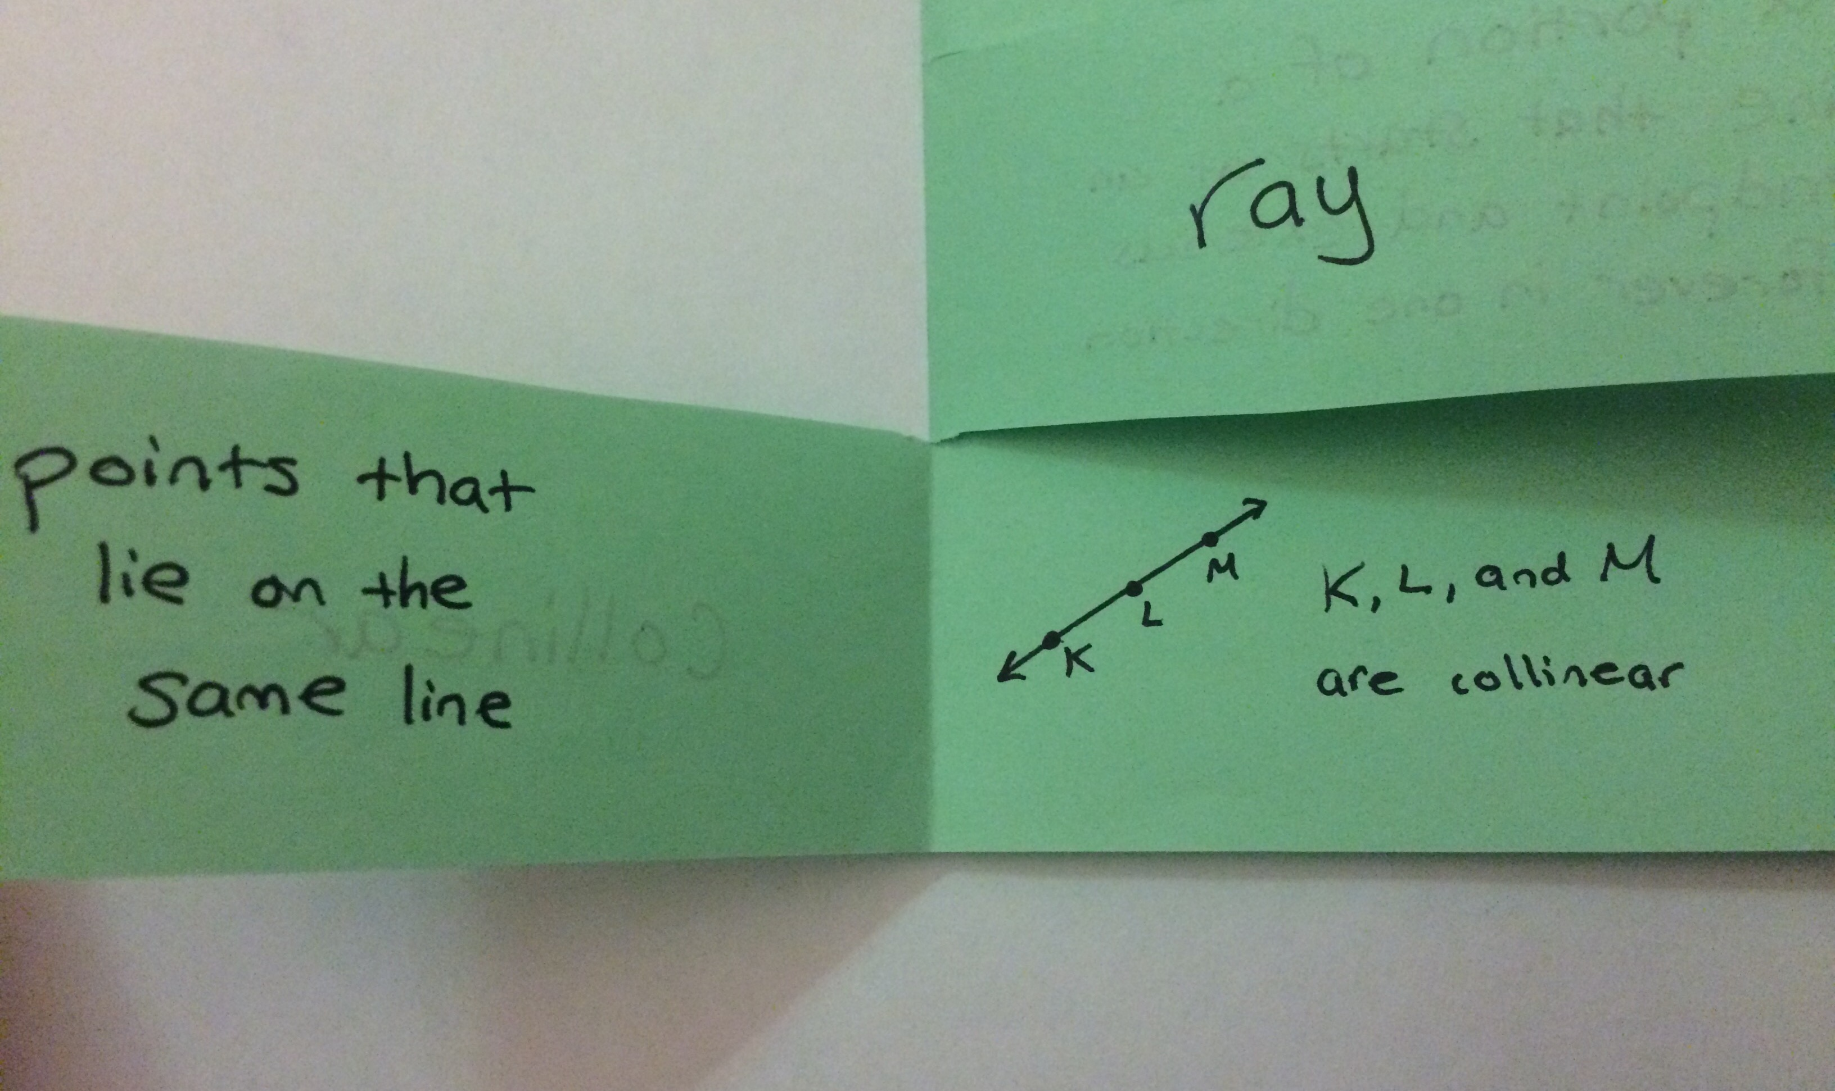
Collinear

Slide 17
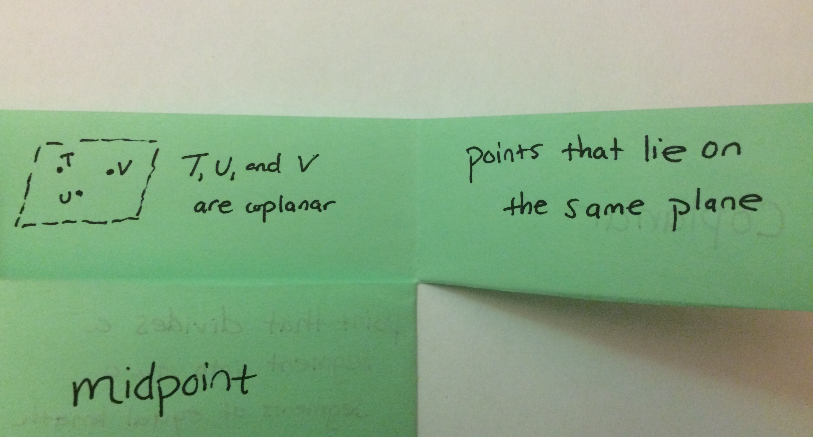
Coplanar

Slide 18
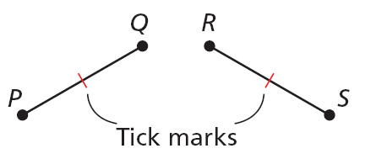
BACK OF FOLDABLE
Congruent segments are segments that have the same length. In the diagram, PQ = RS. Tick marks are used in a figure to show segments of equal length.

Slide 19
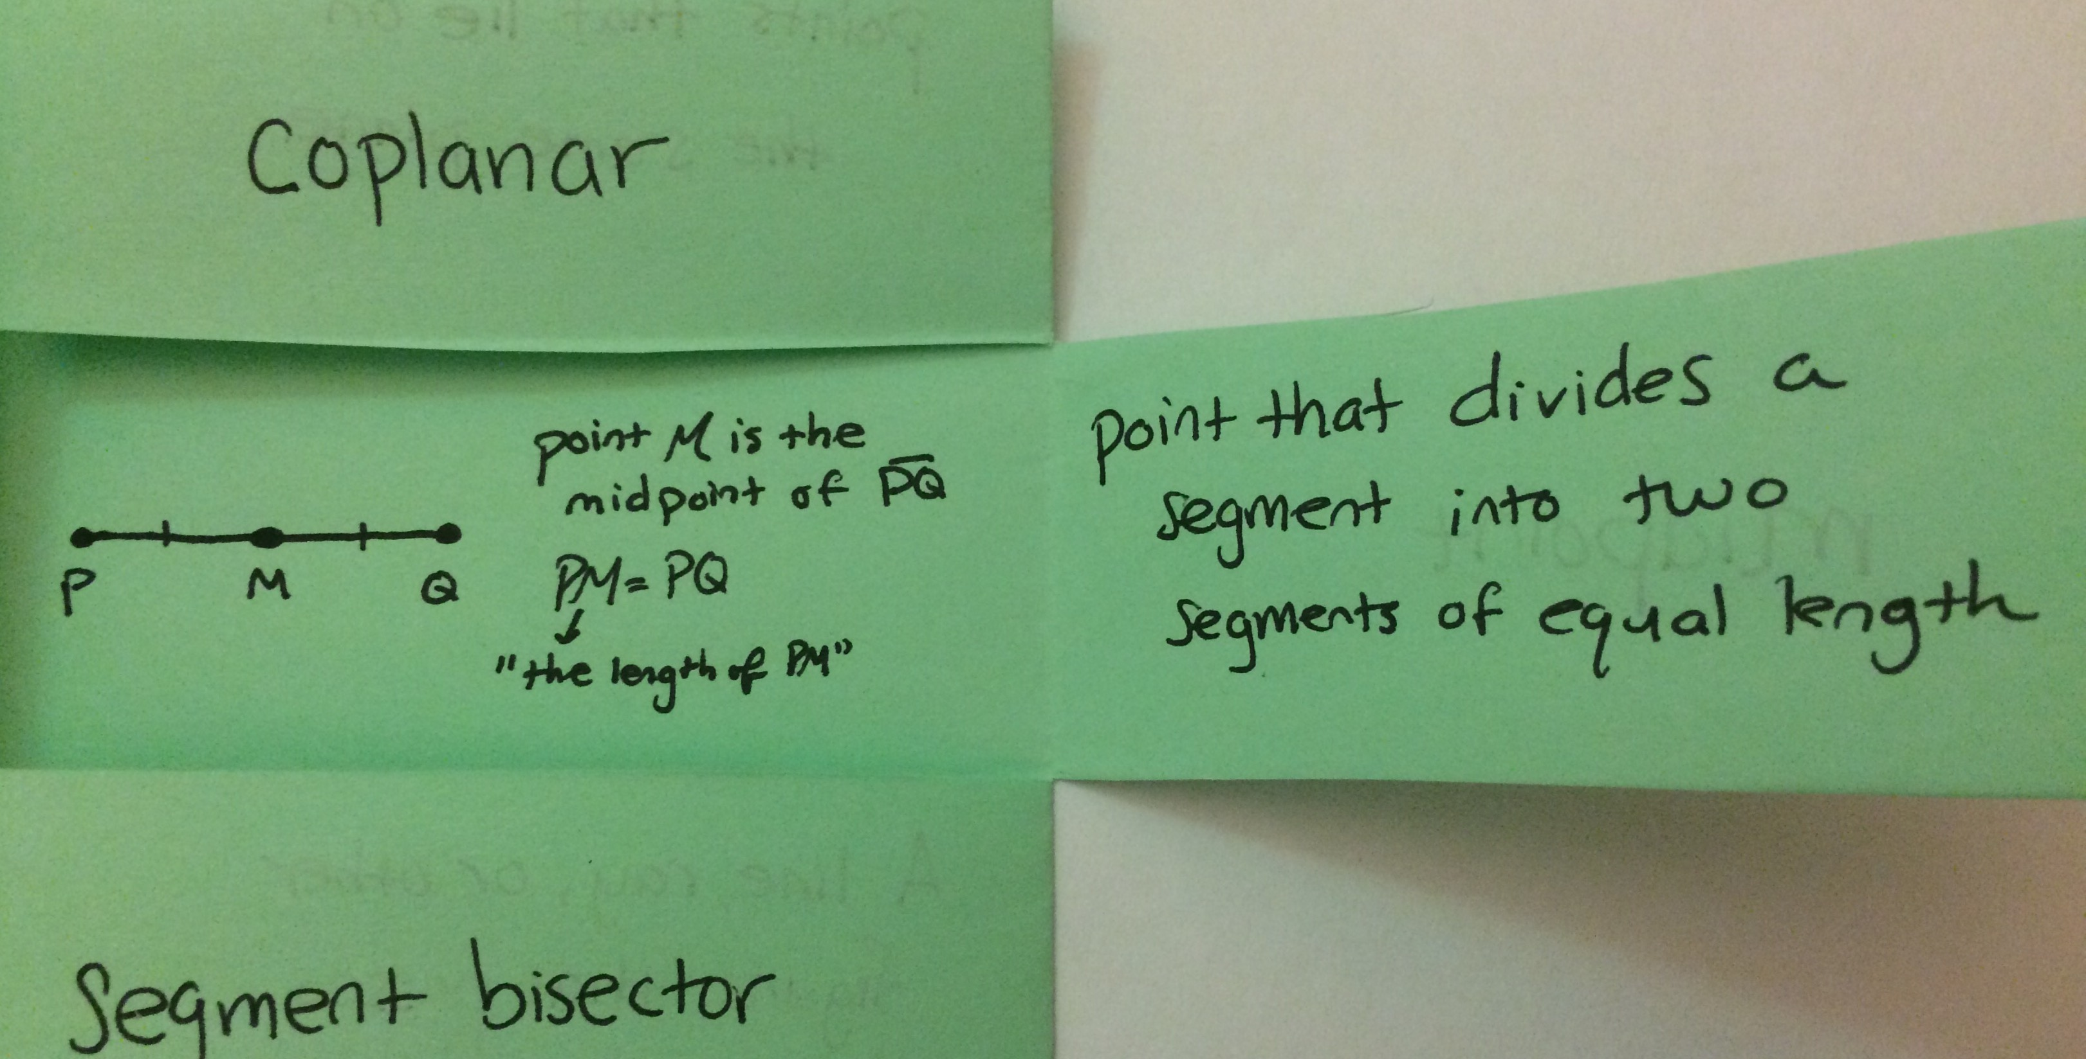
Midpoint

Slide 20
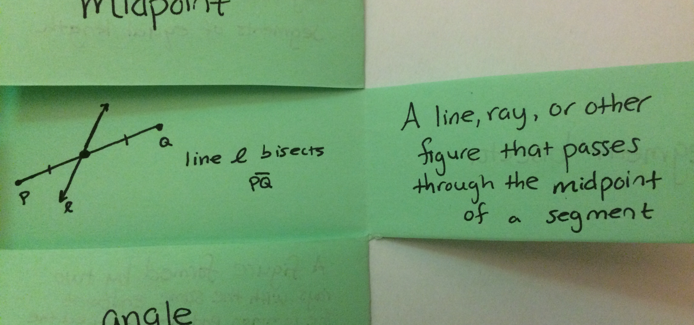
Segment Bisector

